Slide 1



Reflection
Examine and modify the structure and behavior of the program at runtime
Telerik Software Academy
Learning & Development Team
http://academy.telerik.com

Slide 2

Table of Contents
What is Reflection?
Features
Drawbacks
Using Reflection
Loading assemblies
Inspecting types
Dynamic invocation
Generics
Obfuscation
Reflection Examples

Slide 3
What is Reflection?
Examine and modify the structure and behavior of the program at runtime
Inspecting the metadata and compiled code in an assembly
Reflection can be used for observing and/or modifying program execution at runtime
Assembly (exe or dll)
Module
Assembly Manifest
(name, version, culture)
Metadata (including IL) (info for all of the assembly types)
Resources (optional) (text files, images, strings)

Slide 4
When We Use Reflection?
Reflection is used when:
Examining assemblies’ metadata
Examine assemblies’ types
Dynamically invoking methods
Dynamically creating new assemblies, executing and storing them as a file
Inspecting an object at runtime without knowing its class
The JustDecompile tool is an excellent example what .NET reflection can do

Slide 5
Drawbacks and Best Practices
What are the costs:
More code than normal coding
Slower than normal coding
The "golden hammer" principle
Leads to a lot of casting and type checking
Possible magic strings
When using Reflection
First try not to use it
Try to cache all reflected metadata

Slide 6
Practical Reflection Strategy
Dynamically Load Assemblies
Happens one time (at start up)
Dynamically Load Types
Happens one time (at start up)
Cast Types to a Known Interface
All method calls go through the interface
No dynamic method calls – no Method.Invoke
Avoid interacting with private members
Usually balance between performance, safety and flexibility

Slide 7


Loading Assemblies
Load libraries like a boss

Slide 8
System.Reflection. Assembly.Load(…)
Assembly.Load(…) loads existing assembly in the .NET CLR by given
Assembly name or AssemblyName object
It searches for an assembly with the given description (probing) and loads it if it is found
If the assembly is not found throws a FileNotFoundException
Assembly.Load("SampleAssembly, Version=1.0.2004.0,
Culture=neutral, PublicKeyToken=8744b20f8da049e3");

Slide 9
System.Reflection. Assembly.LoadFrom(…)
Assembly.LoadFrom(…) loads assembly from existing local file
Takes the path to the assembly as a parameter
Reads the given file and loads it in the CLR
If the assembly is not found throws a FileNotFoundException
Assembly.LoadFrom(@"C:\Tools\MyAssembly.dll");

Slide 10
System.Reflection. Assembly – Properties
FullName – the assembly's full name
Including version, culture and key (Public Key Token)
Location – the file name from which the assembly is loaded
EntryPoint – the method by which the assembly will start (Main() method)
GlobalAssemblyCache – indicates whether the assembly is loaded from the GAC

Slide 11

Loading Assemblies
Live Demo

Slide 12

The System.Type Class
System.Type
.NET Framework

Slide 13
The System.Type Class
System.Type
A starting point for inspecting .NET types
Provides access to all type members:
Fields
Methods
Properties
Events
Inner types
…

Slide 14
The System.Type Class (2)
Assembly.GetTypes() allows listing all types contained in a given assembly
Properties:
Methods:
BaseType, Attributes, FullName, IsAbstract, IsArray, IsByRef, IsClass, IsCOMObject, IsEnum, IsInterface, IsPublic, IsSealed, IsValueType, Name, …
GetConstructors(), GetEvents(), GetFields(), GetInterfaces(), GetMembers(), GetMethods(), GetNestedTypes(), GetProperties(), InvokeMember(), IsInstanceOfType()

Slide 15
Inspecting Type Members
Assembly currAssembly =
Assembly.GetExecutingAssembly();
foreach(Type type in currAssembly.GetTypes())
{
foreach(MemberInfo member in type.GetMembers())
{
Console.WriteLine("{0}.{1}",
member.MemberType, member.Name);
}
}

Slide 16


Inspecting Type Members
Live Demo

Slide 17
Classes in the MemberInfo Hierarchy
System.Reflection.MemberInfo
System.Reflection.EventInfo
System.Reflection.FieldInfo
System.Reflection.MethodBase
System.Reflection.ConstructorInfo
System.Reflection.MethodInfo
System.Reflection.PropertyInfo
System.Type

Slide 18
Inspecting Methods and their Parameters
Type.GetMethod()
Returns the reflection of a given method
MethodInfo.GetParameters()
Extracts the method’s parameters
MethodInfo someMethod =
myType.GetMethod("SomeMethod");
foreach(ParameterInfo param in
someMethod.GetParameters())
{
Console.WriteLine(param.ParameterType);
}

Slide 19
Dynamic Method Invocation (Late Binding)
We create type object instance by the Activator class
CreateInstance(…)
Creates an instance of given type specified as Type object or string
CreateComInstanceFrom(…)
Creates COM object instance
System.MethodInfo.Invoke(…)
Dynamically invokes a method

Slide 20

Dynamic Method Invocation
Live Demo

Slide 21
Reflection and Generics
.NET reflection supports generics
Can get the generic parameters at runtime
Some of the generic reflection APIs:
MethodInfo.IsGenericMethod()
MethodInfo.GetGenericArguments()
Type.IsGenericType()
Type.GetGenericTypeDefinition()
…

Slide 22
Obfuscation
A way to make IL code less readable
Private variables, fields and parameters renames to "nonsense" or unprintable names
Other techniques that breaks decompilers but the IL code is still valid
Public member names remain unchanged
Similar to JavaScript minification
Ultimately, this is an ongoing battle between the obfuscators and the decompilers

Slide 23
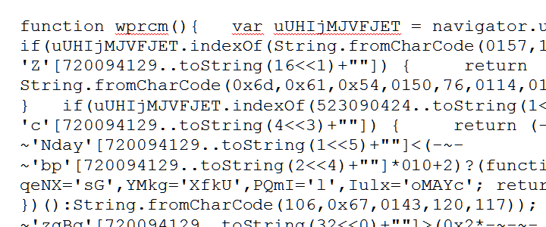
Obfuscation
Live Demo with Confuser

Slide 24
Real World Examples
Plugin System, Validator, Serialization, Unit Testing

Slide 25
Reflection

